Slide 1
CSD4464 Section 4 2019W
Course Project Instruction Notes
Instructor: Peter Sigurdson

Slide 2
JSP WEB PAGE
Form:
Fields
Submit button
SERVLET
TAKE INFORMATION FROM THE JSP
PUSH IT TO THE DATABASE
TAKE THE RESULT SET BACK FROM THE DATABASE
PUSH IT TO THE JSP
MySQL database
We are using the development database embedded in NetBeans

Slide 3
Project Requirements
You can work in teams of up to 3 people.
Make sure your team members are registered in the Project Database on Moodle.
You will construct a Java 2 Enterprise Edition Web Application with a JSP Front End, and a MySQL database, that will allow College Students to register themselves into Classes.
Resources: Your Project Worksheet: Available in Moodle
Instructional Video: https://vimeo.com/329545058

Slide 4
Grading Rubric:
Creating the Database in MySQL in NetBeans | 20% | For the full 25%, you must create all tables and an SQL Statement that will enroll students in their choice of classes. You will be using this SQL Statement in the next section under Program Control.
Implement the JSPs for the User Interface | 20%
Implement the middleware (Controller) components to mediate the connection between the JSPs and the Database. | 20%
Present your final project to the Instructor. Each team member must be able to answer questions about the Design for proof of work that everyone participated. | 20%
Your work is properly committed and versioned in GitHub. Your SQL Statements are in GitHub. | 20%

Slide 5
Project Deliverable:
CSD4464 Project FilesPage
CSD4464 Project FilesPage
A Java Web Application with a JSP that presents students with a Web Page which they can use to Enroll themselves in Classes.
A Database which will provide the “Model” layer of the Model View Controller Architecture.
Additional Components which you must development. This is your project! See “CSD4464 Project Files” in the Moodle Page for a link to the PDF with the instructions on .

Slide 6
There are 2 ways available to us to create the Database for the Enrollment System:
Use MySQL Database and the MySQL Workbench
Use the Database manage tools built into NetBeans

Slide 7
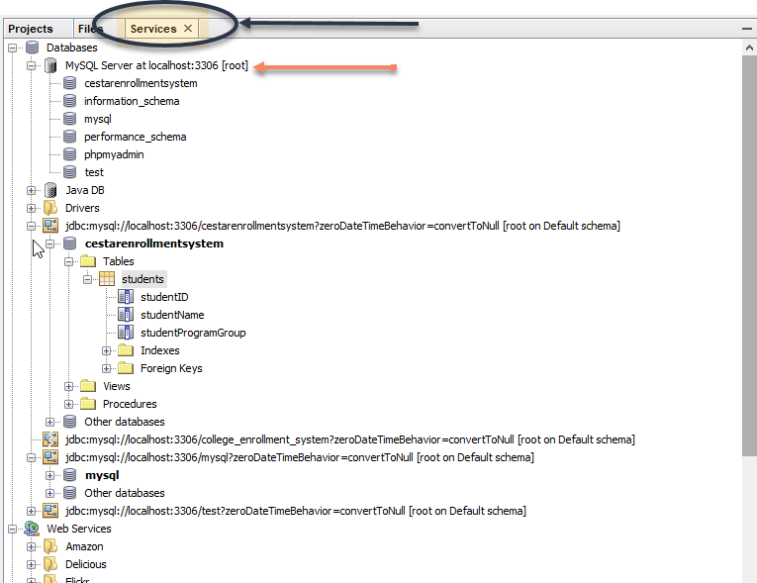
Use the Database manage tools built into NetBeans
https://netbeans.org/kb/docs/ide/mysql.html

Slide 8
Following the Discussion in class, create a Student Enrollment Database using the tools provided by NetBeans:
You can study the documentation available at:
https://netbeans.org/kb/docs/ide/mysql.html
to see detailed procedures of how to use Netbean’s Data Handling Tools.
The next slide provides the Data Set which you must implement:
For help with SQL, refer to w3schools.com/SQL

Slide 9
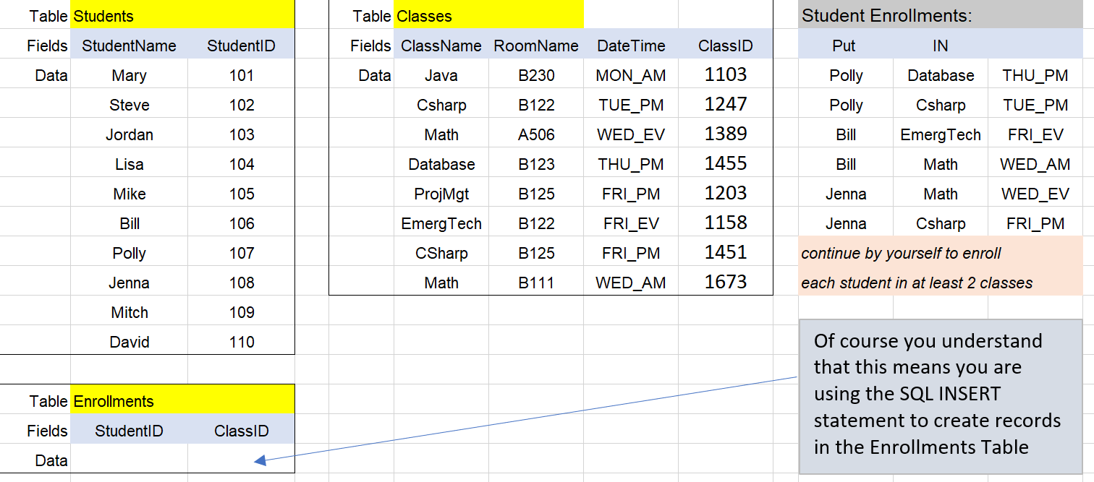
Using the skills you learned in Relational Databases and SQL, create a Database that implements the following Data Set, using NetBeans SQL Client:

Slide 10
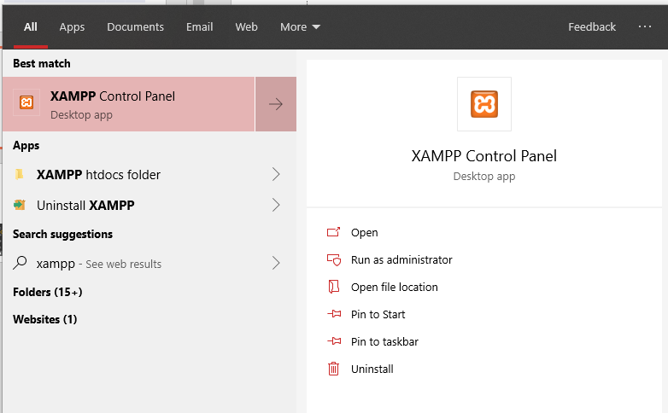
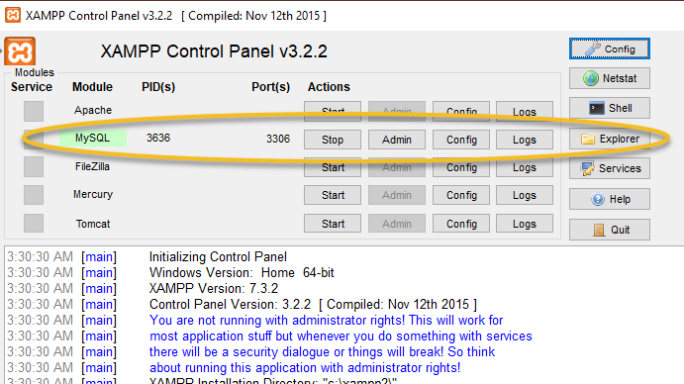
Database: MySQL
Your Workstation is equipped with XAMPP with includes MySQL.
Start MySQL from the Control Panel
Start XAMPP from the Windows 10 Start Menu

Slide 11
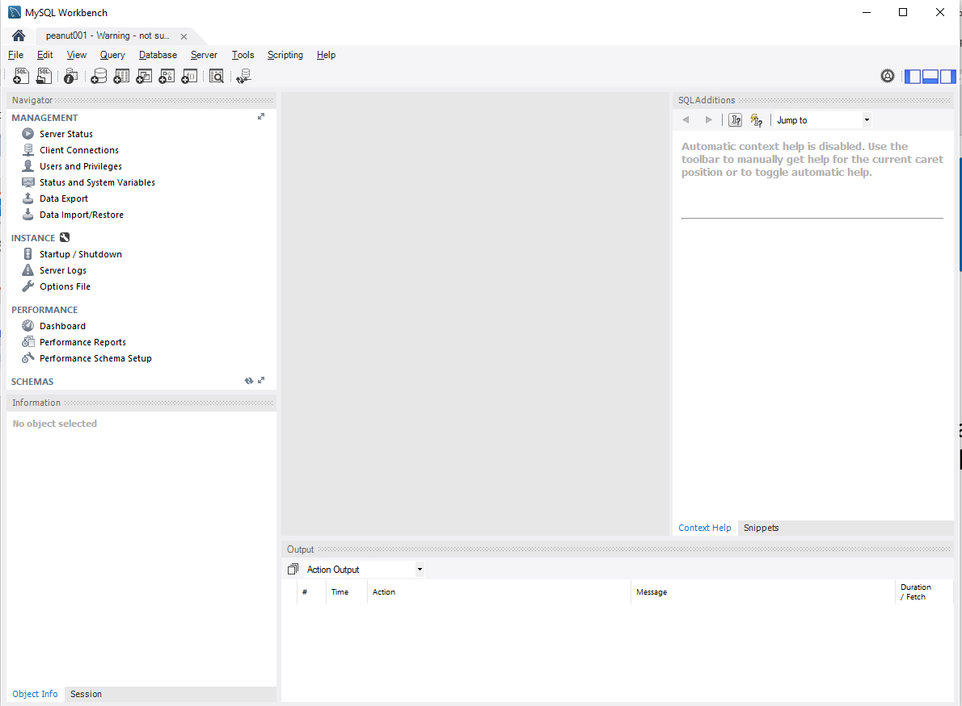
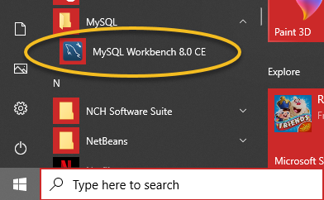
Project Tools: MySQL Workbench
MySQL is a SERVER, like the Glassfish. Servers respond to requests. They do not provide DEVELOPMENT TOOLS.
Your development tool to write SQL to control the MySQL server is MySQL Workbench.

